Slide 1
The F-Distribution

Slide 2
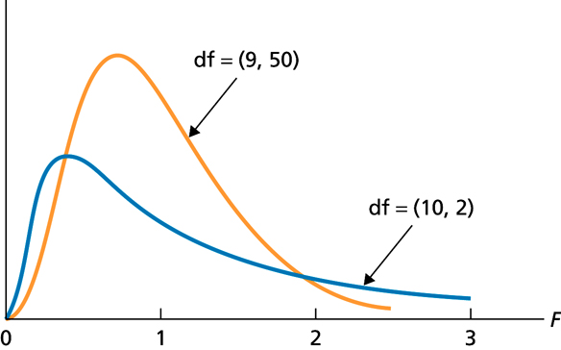
Figure 13.1
Two different F-curves

Slide 3
Key Fact 13.1
Basic Properties of F-Curves
Property 1: The total area under an F-curve equals 1.
Property 2: An F-curve starts at 0 on the horizontal axis and extends indefinitely to the right, approaching, but never touching, the horizontal axis as it does so.
Property 3: An F-curve is right skewed.

Slide 4
One-Way ANOVA: The Logic

Slide 5
Key Fact 13.2
Assumptions (Conditions) for One-Way ANOVA
Simple random samples: The samples taken from the populations under consideration are simple random samples.
Independent samples: The samples taken from the populations under consideration are independent of one another.
Normal populations: For each population, the variable under consideration is normally distributed.
Equal standard deviations: The standard deviations of the variable under consideration are the same for all the populations.

Slide 6
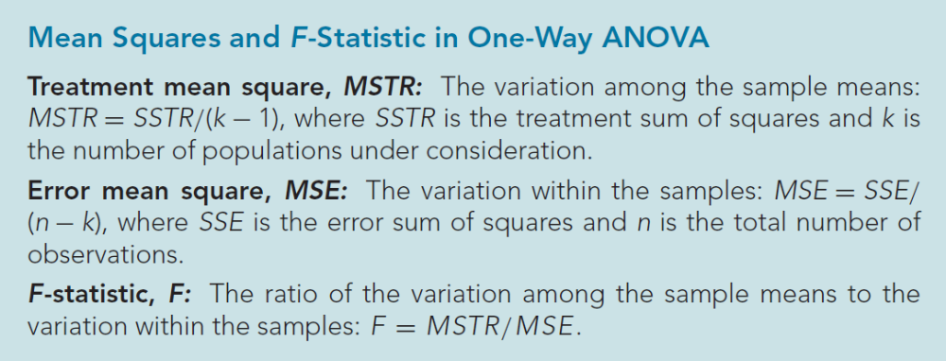
Definition 13.1

Slide 7
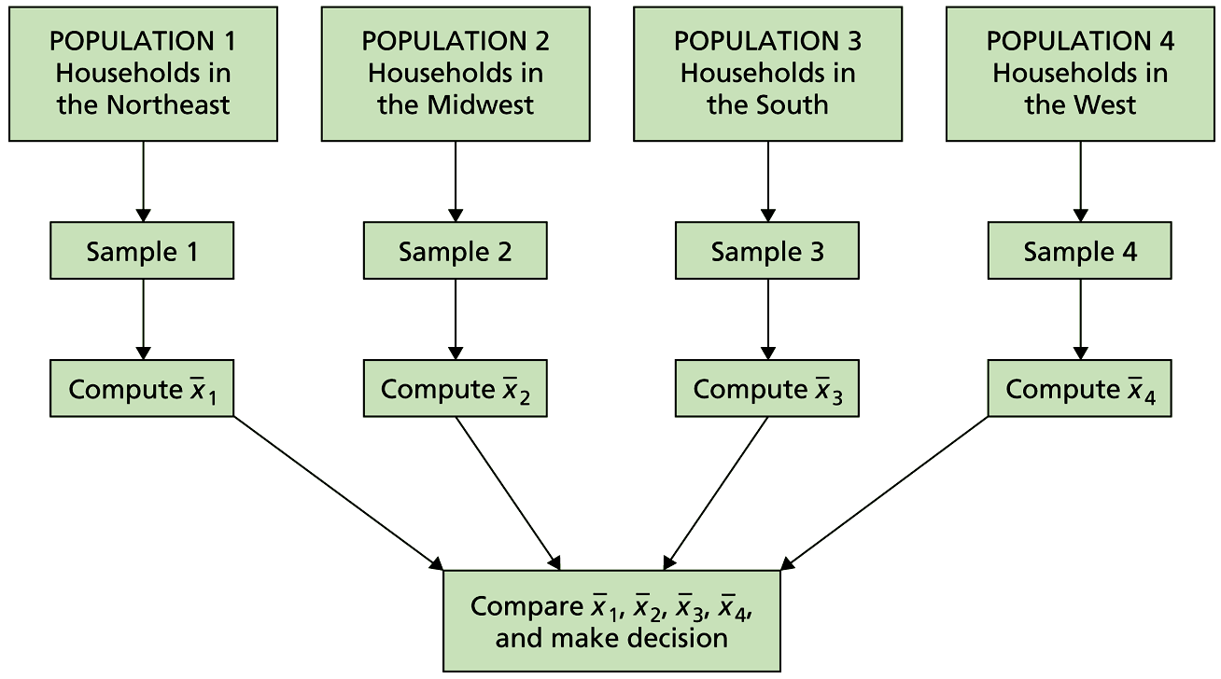
Figure 13.5
Process for comparing four population means

Slide 8
One-Way ANOVA: The Procedure

Slide 9
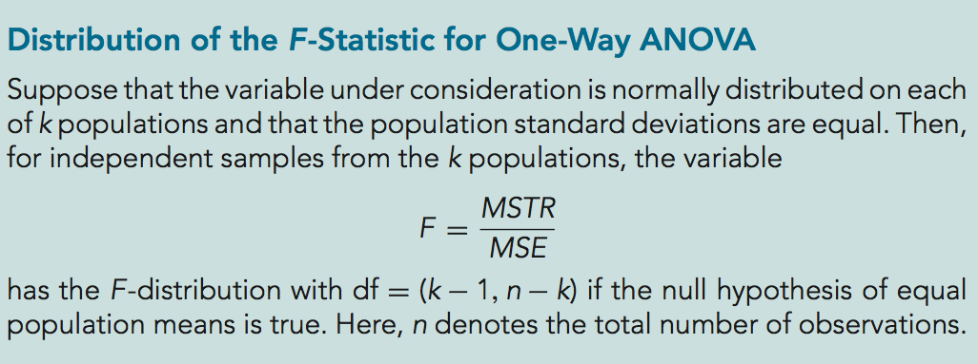
Key Fact 13.3

Slide 10
Key Fact 13.4
One-Way ANOVA Identity
The total sum of squares equals the treatment sum of squares plus the error sum of squares: SST = SSTR + SSE.

Slide 11
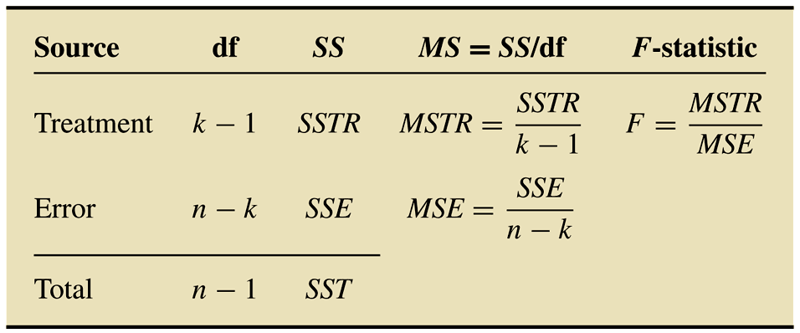
Table 13.6
ANOVA table format for a one-way analysis of variance

Slide 12
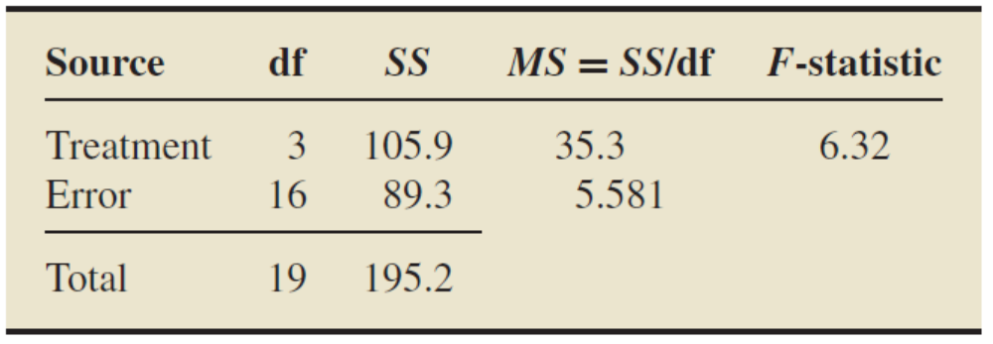
Table 13.7
One-way ANOVA table for the energy consumption data

Slide 13
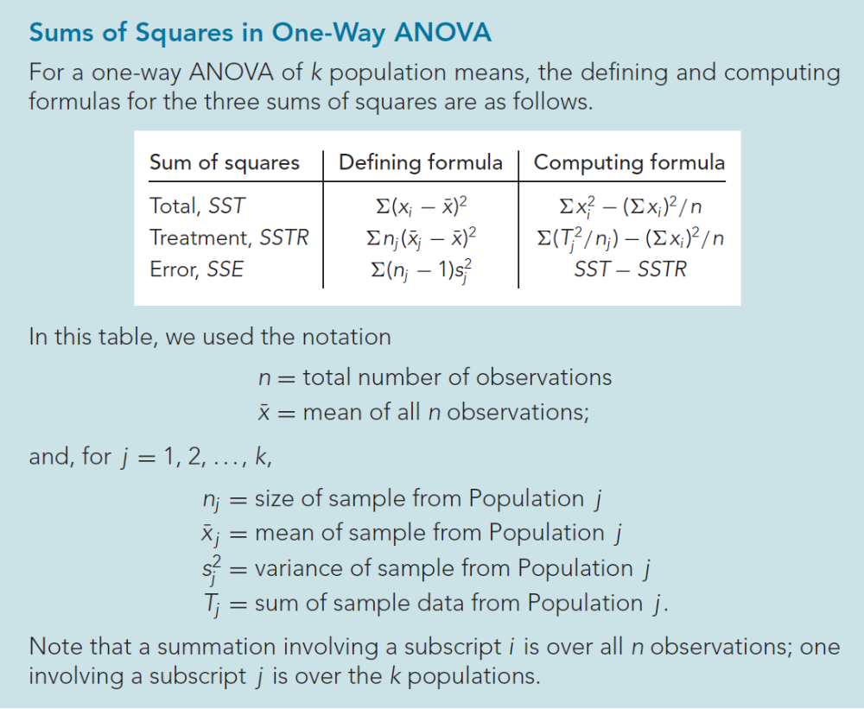
Formula 13.1

Slide 14
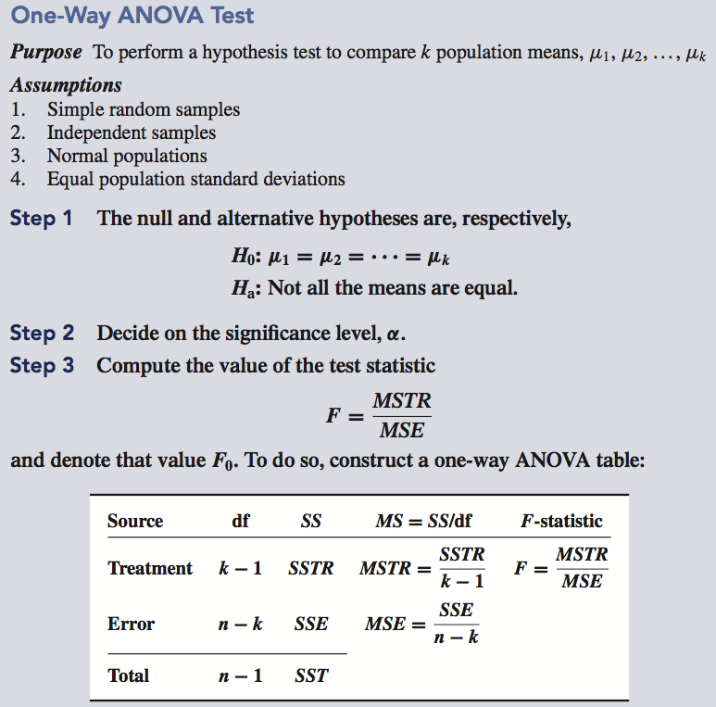
Procedure 13.1

Slide 15
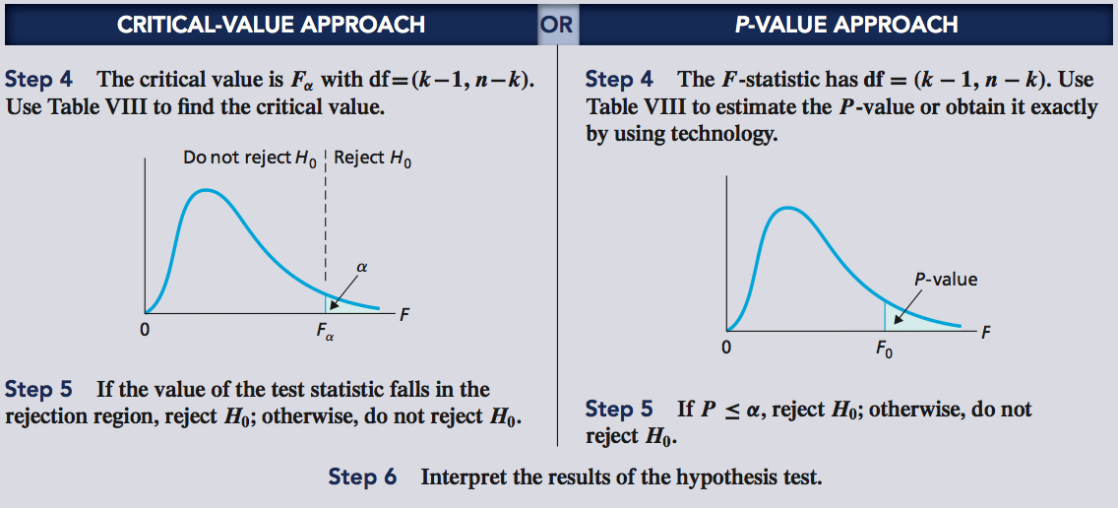
Procedure 13.1 (cont.)

